Slide 1

Pizza Sales Data Analysis Report
A comprehensive SQL-driven performance overview capturing operational KPIs, product metrics, and key inventory insights for business growth.
PIZZA PERFORMANCE DA
SLIDE 1 OF 8

Slide 2
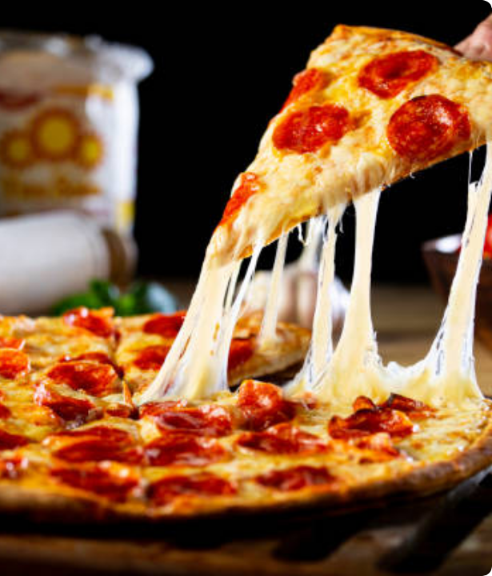
Analyzing pizza_sales.xlsx
This analytics deck leverages the robust database provided in the verbatim "pizza_sales.xlsx" source file. SQL queries were executed to pull transaction-level insights across 21,350 unique orders and 49,574 individual items sold.
We target operational excellence by investigating sales distribution across categories, size variations, peak ordering times, and distinct item-level revenue champions and underperformers.
PROJECT BASELINE
SLIDE 2 OF 8

Slide 3




Key Performance Indicators
$817,860
$38.31
49,574
21,350
2.32
TOTAL REVENUE
AVG ORDER VALUE
PIZZAS SOLD
TOTAL ORDERS
AVG PIZZAS / ORD
Consolidated sales across all pizza categories.
Calculated directly from distinctive order totals.
Total cumulative volume of pizzas ordered.
Distinct invoices logged in the database.
Average quantity purchased per distinct checkout.
HIGH-LEVEL PERFORMANCE SUMMARY
SLIDE 3 OF 8

Slide 4
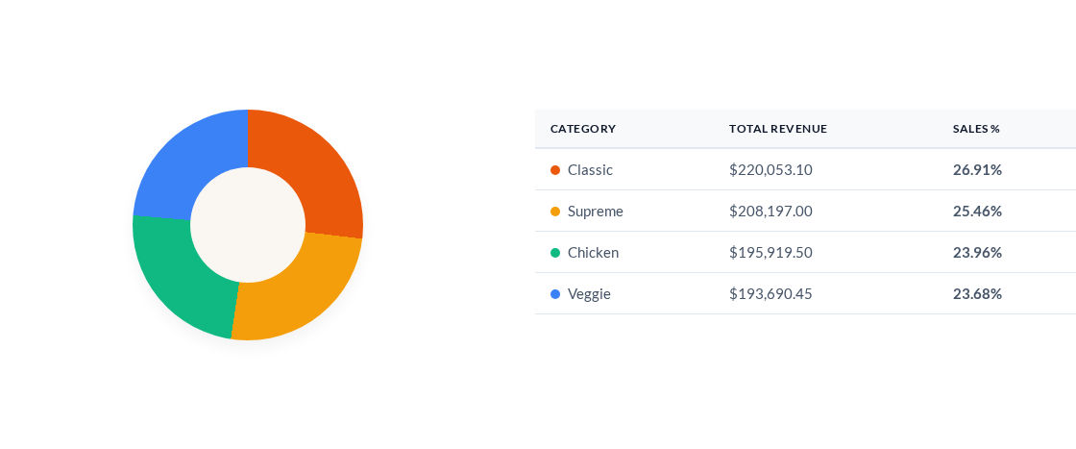
Sales Proportion by Category
CATEGORICAL SHARE ANALYSIS
SLIDE 4 OF 8

Slide 5
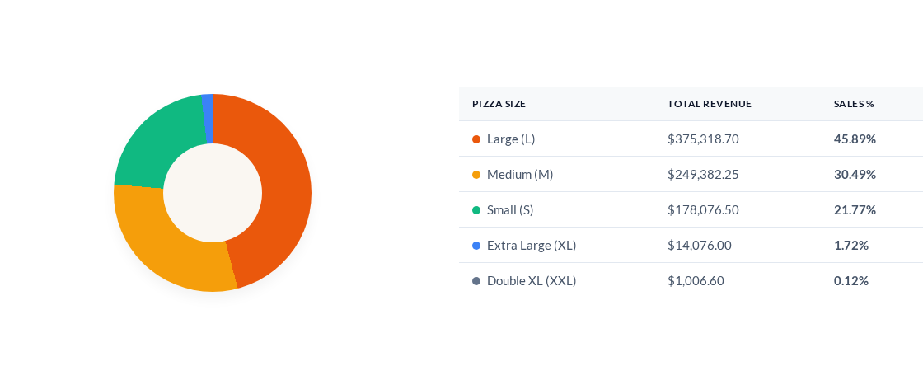
Sales Proportion by Size
DIMENSIONAL VOLUME & VALUE
SLIDE 5 OF 8

Slide 6
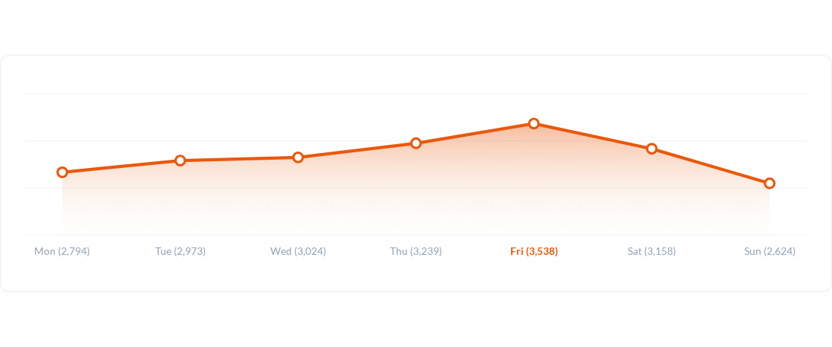
Weekly Order Distribution
WEEKLY PEAK PATTERNS
SLIDE 6 OF 8

Slide 7
Product Performance Revenue
Top 5 Revenue Generators
Bottom 5 Revenue Generators
Pizza Name | Revenue
The Thai Chicken Pizza | $43,434.25
The Barbecue Chicken Pizza | $42,768.00
The California Chicken Pizza | $41,409.50
The Classic Deluxe Pizza | $38,180.50
The Spicy Italian Pizza | $34,831.25
Pizza Name | Revenue
The Brie Carre Pizza | $11,588.50
The Green Garden Pizza | $13,955.75
The Spinach Supreme Pizza | $15,277.75
The Mediterranean Pizza | $15,360.50
The Spinach Pesto Pizza | $15,596.00
STRATEGIC INVENTORY & MENU INSIGHTS
SLIDE 7 OF 8

Slide 8
Key Strategic Recommendations
Friday Operational Optimization: Peak volume occurs consistently on Fridays (3,538 orders). Ensure kitchen staffing is maximized during peak Friday evening hours.
Gourmet Size Marketing: Since Large (L) pizzas generate 45.89% of sales, run upselling campaigns promoting upgrade bundle options on Medium (M) sized orders.
Underperformer Adjustments: Address low revenue for pizzas like *The Brie Carre Pizza* ($11,588.50) through targeted test promotions or recipe optimization to prevent wasted inventory.
STRATEGIC ROAD MAP
SLIDE 8 OF 8

